Slide 1
CHEMIST SHOP MANAGEMENT
Presented By:
Sowmya Shree and Sneha

Slide 2
Introduction
A Chemist Shop Management System is a software application designed to streamline and automate the processes involved in managing a pharmacy or chemist shop. It enables efficient handling of a wide range of tasks, from managing inventory (medicines, medical supplies) to tracking sales, billing, and stock replenishment. The system facilitates both the administrative and operational aspects of a chemist shop, helping owners and staff efficiently manage daily activities, reduce errors, and enhance customer service

Slide 3
Objectives
Track stock levels of medicines in real-time.
Automatically update stock quantities when medicines are added or sold.
Monitor expiry dates to ensure expired medicines are removed on time
Generate accurate and quick bills for customers.
Calculate total amounts, taxes, and discounts automatically.
Maintain transaction history for future reference and auditing.

Slide 4
About the Dataset
Source: The dataset will be sourced from Kaggle.
Features: Key features include Order ID, Product names, Sales quantity, Timestamps, Regions and Customer feedback.
Purpose:
Identify the best-selling and least popular grocery items.
Analyze time-series data to predict customer demand and optimize inventory.
Enhance service efficiency through data-driven decision-making.

Slide 5
METHODOLOGY
Data Collection: The dataset will be sourced from Kaggle.
Database Connectivity: Establish a connection to the chem database using tools like MySQL for real-time data querying.
Exploratory Data Analysis (EDA): Handle missing data using imputation techniques, Summarize the dataset using descriptive statistics and Create visualizations (e.g., histograms, box plots, and correlation heatmaps) to understand sales trends, feature distributions, and interactions.
Visualization: Generate visual representations (e.g., dashboards, bar charts, and line graphs) to highlight findings and support decision-making.

Slide 6
TOOLS AND TECHNOLOGIES
Programming Language: Python.
Libraries: Pandas, NumPy, Matplotlib, Seaborn and mysql.connector.
Database: PostgreSQL/MySQL for backend data storage.
IDE: Jupyter Notebook or any Python-compatible IDE.

Slide 7
EXPLORATORY DATA ANALYSIS (EDA)
Importing Libraries: Import essential libraries for data manipulation and visualization.
Loading Dataset: Establish a connection to the database and load the data into a Pandas DataFrame.
Basic Exploration : Perform an initial examination of the dataset to understand its structure.
Checking Missing Values: Identify missing values in the dataset.
Descriptive Statistics: Summarize the dataset to understand the central tendency and spread of the data.
Identifying Duplicates: Check for duplicate rows in the dataset.
Data Visualization: Use visualizations to gain more insights into the data.

Slide 8
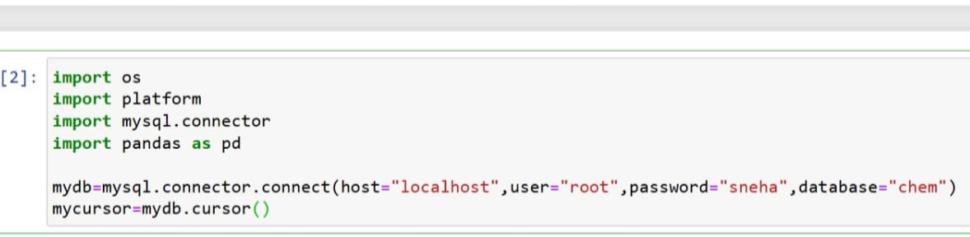
Database Connectivity
Step-by-Step Process:
Database Setup:
Configure PostgreSQL/MySQL with schema matching the dataset.
Python Integration:
Use MySQL for connectivity.
Code Snippet:

Slide 9
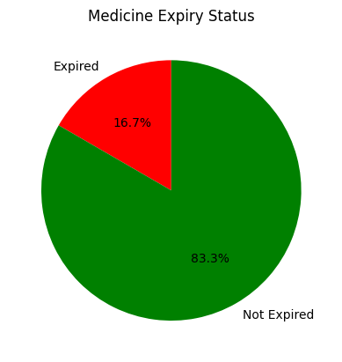
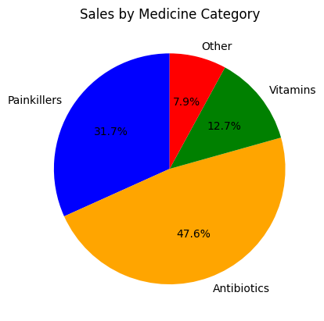
ANALYSIS QUESTIONS

Slide 10
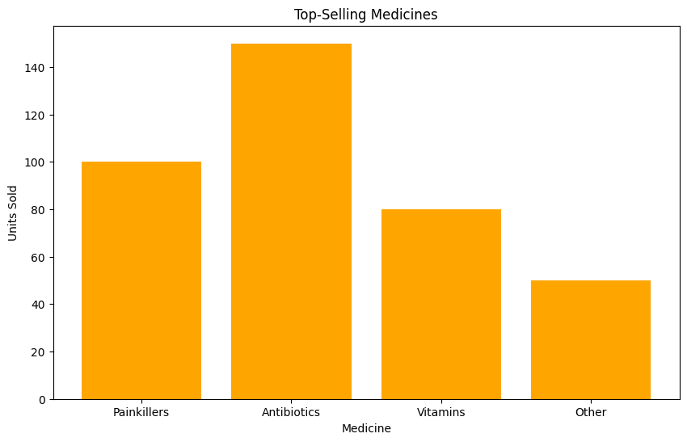
Total sales by Outlet Location Type

Slide 11
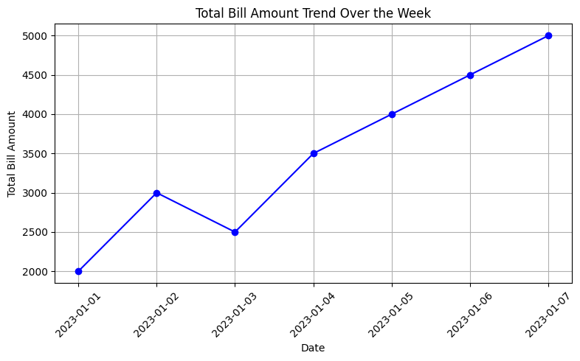

Slide 12
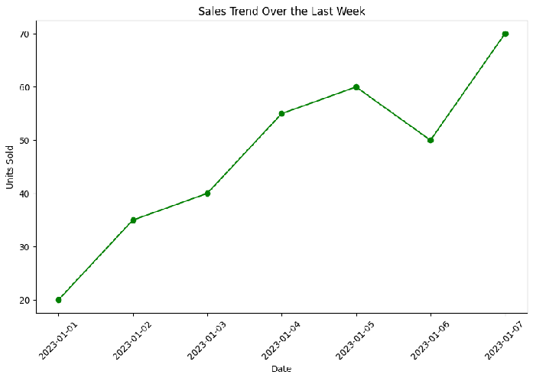
Trend of average sales over the years

Slide 13
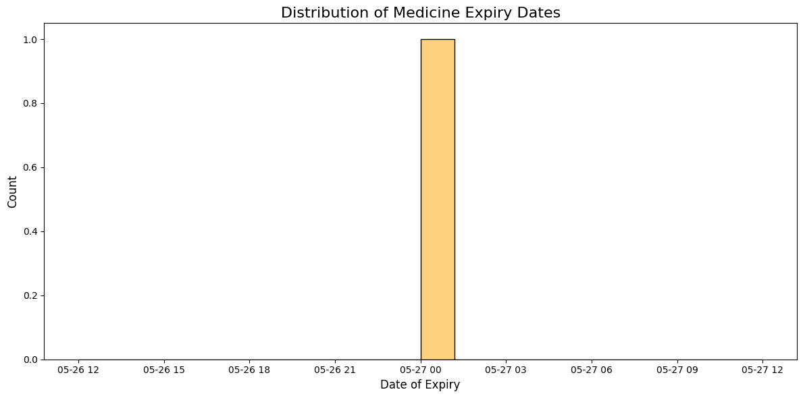

Slide 14
Conclusion
The Chemist Management System successfully streamlines and automates the essential operations of a pharmacy or chemist shop, enhancing both efficiency and accuracy. By integrating functionalities such as inventory management, sales tracking, billing, and customer record maintenance, the system minimizes manual effort and reduces the chances of errors.

Slide 15
THANK YOU!

